Slide 1
Semaphores
Exercises n. 3

Slide 2
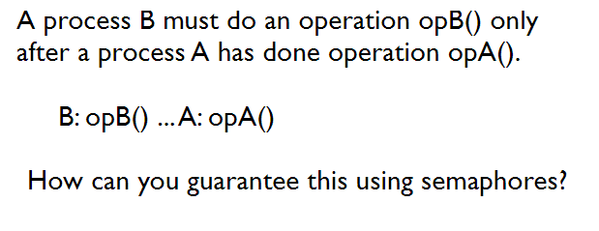
Exercise 1

Slide 3
Exercise 1- solution
Semaphore S=0
Process B Process A
P(S); A: opA();
B: opB(); V(S);

Slide 4
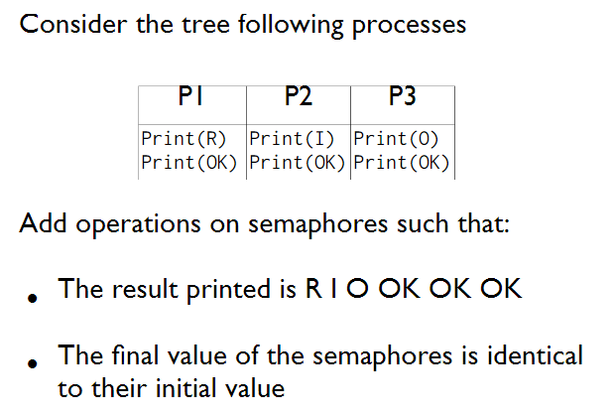
Exercise 2

Slide 5
Exercise 2: soluzione
P1 | P2 | P3
Print(R); V(S1); P(S3); Print(OK); V(S3); | Print(I); V(S2); P(S3); Print(OK); V(S3); | Print(O); V(S3); P(S3); Print(OK); V(S3);
Semaphore S1=0, S2=0, S3=0

Slide 6
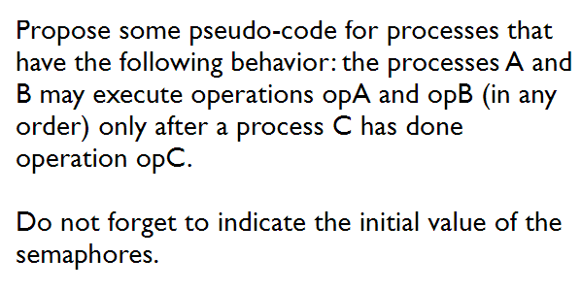
Exercise 3

Slide 7
Exercise 3 - solution
Semaphore S=0; //generalized
Process A | Process B | Process C
P(S); OpA(); | P(S); OpB(); | OpC(); V(S); V(S);

Slide 8
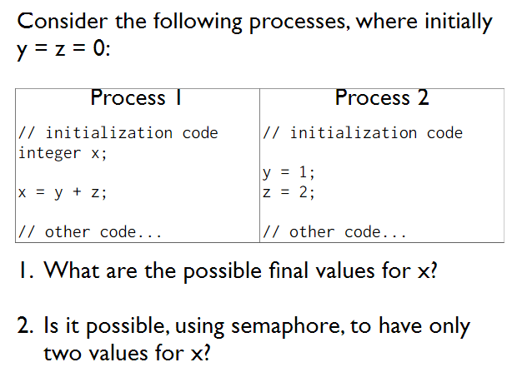
Exercise 4

Slide 9
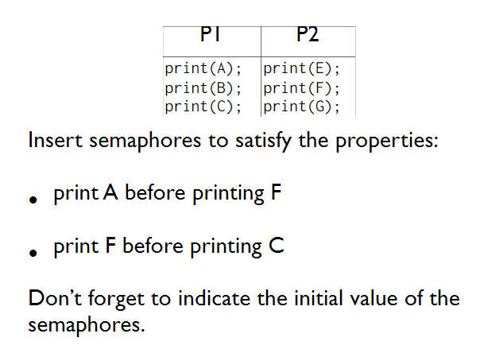
Exercise 5

Slide 10
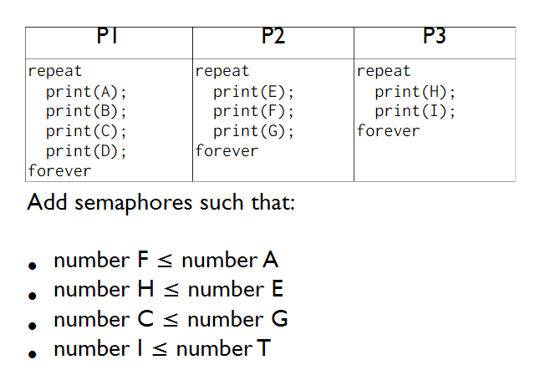
Exercise 6

Slide 11
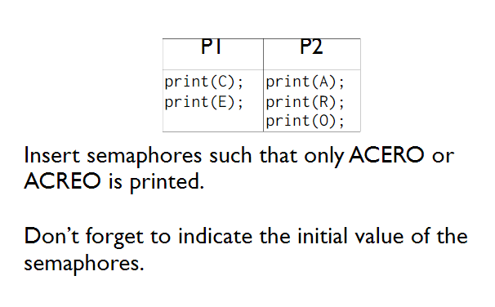
Exercise 7

Slide 12
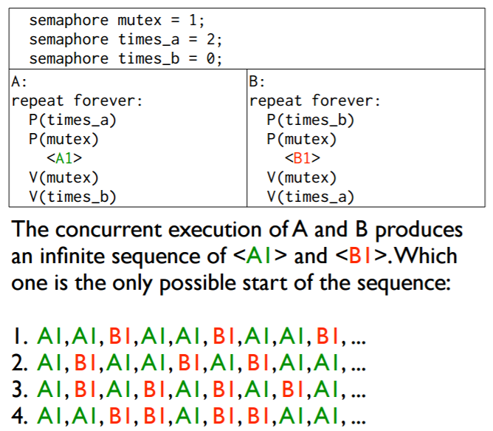
Exercise 8

Slide 13
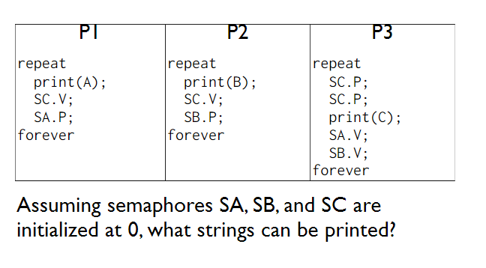
Exercise 9

Slide 14
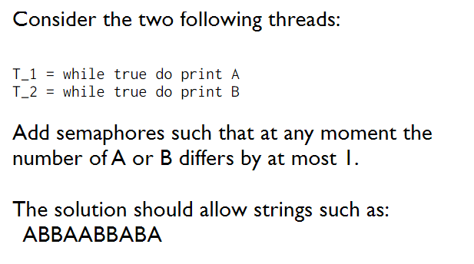
Exercise 10

Slide 15
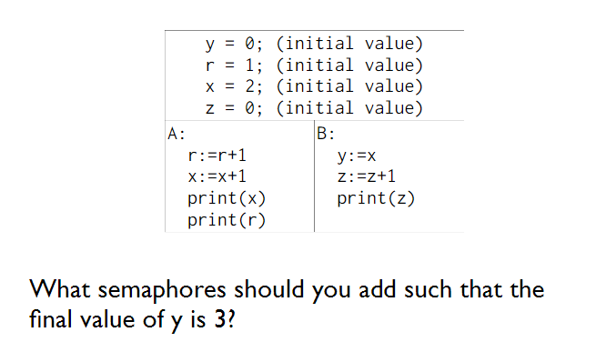
Exercise 11

Slide 16
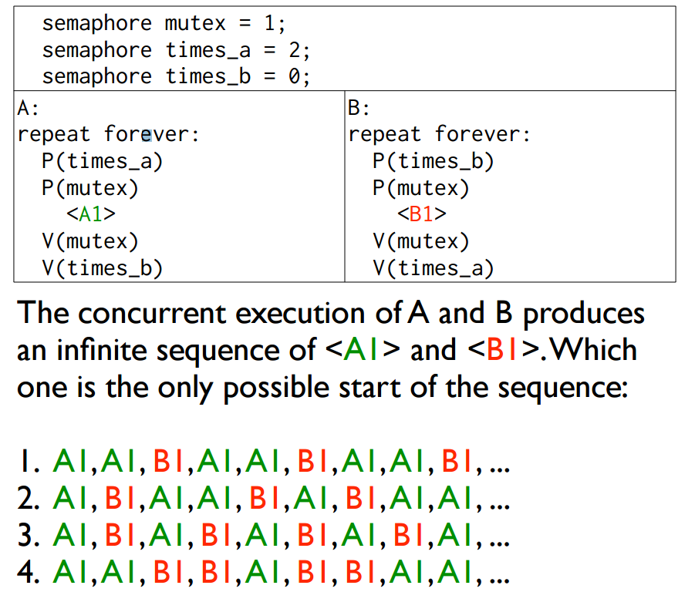
Exercise 12

Slide 17
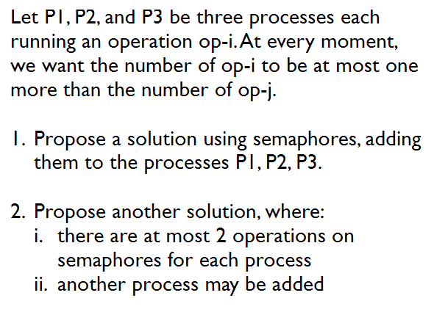
Exercise 13

Slide 18
Exercise 14
Given the following processes:
1. How many different outputs could this programs produce? Explain your reasoning.
2. Add semaphores to the program so that the six lines of output are printed in the order 1,2,3,4,5,6.
Declare and initialize any semaphores you need and add P and V operations to the above processes.
process P1 | process P2 | process P3
{ write(‘‘line 1’’); write(‘‘line 2’’); } | { write(‘‘line 3’’); write(‘‘line 4’’); } | { write(‘‘line 5’’); write(‘‘line 6’’); }

